Slide 1





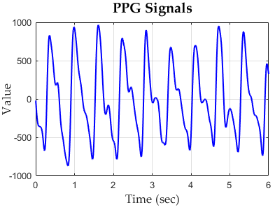
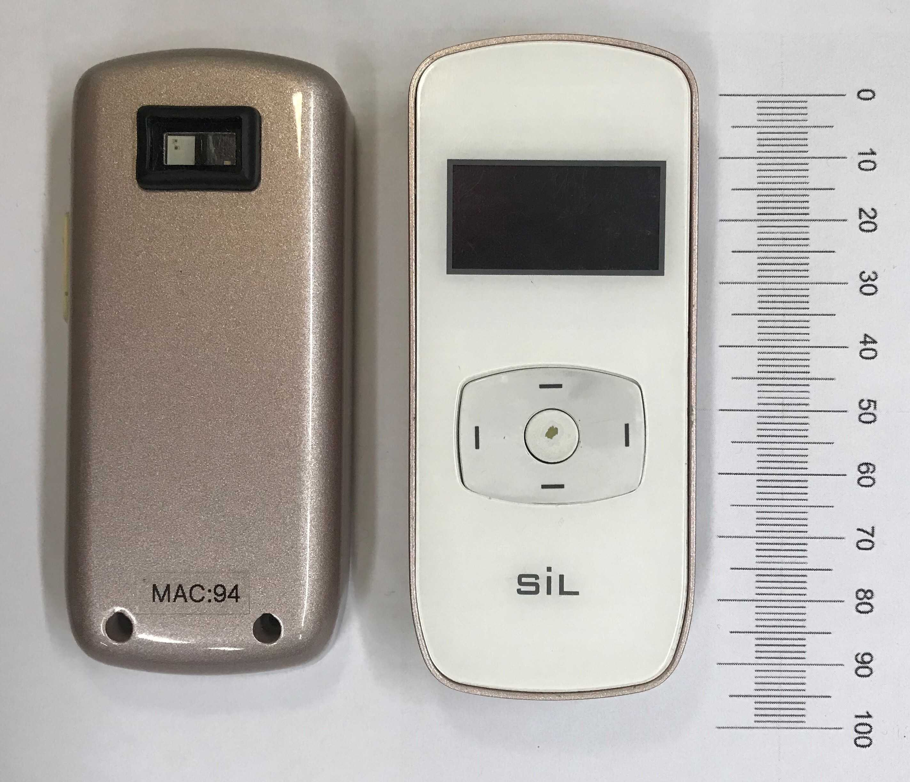
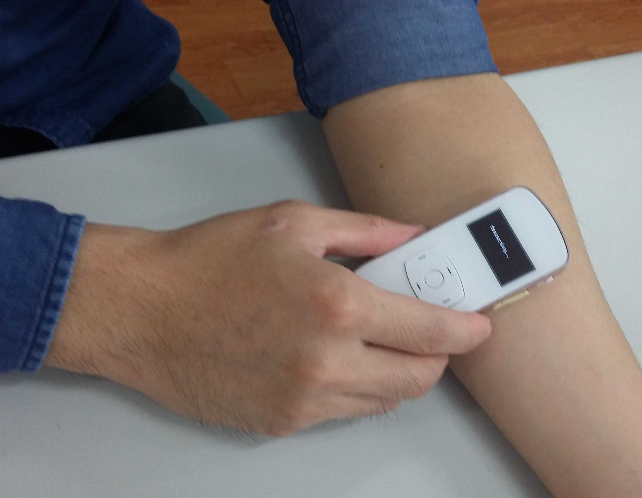
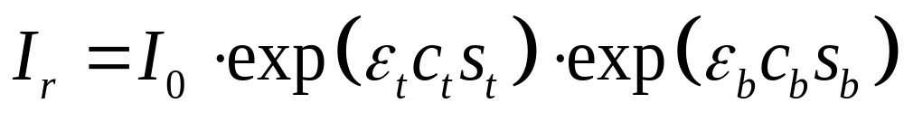
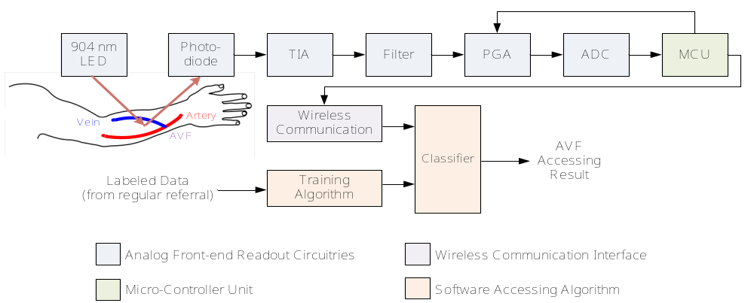
Lab website
Prof. Dr. Paul Chao
National Chiao Tung University Taiwan
1. BACKGROUND AND MOTIVATION
2. THEORY AND PRINCIPLE
2. THEORY AND PRINCIPLE
Support vector machine (SVM) learning for assessing quality of arteriovenous fistula (AVF) at hemodialysis patients using a new photoplethysmography (PPG) sensor for providing
Monitoring Blood Flow at home.
Inexpensive, small-sized and easy-to-use solution needed.
Photoplethysmography (PPG) sensor
Non-invasive method aiming at sensing the pulsation of Blood Vessel.
Evaluating the reflective lights from LED and PD.
The mathematical equation of a PPG signal using Beer Lambert’s law, as
Photoplethysmography (PPG) sensor
Non-invasive method aiming at sensing the pulsation of Blood Vessel .
Evaluating the reflective lights from LED and PD.
The mathematical equation of a PPG signal using Beer Lambert’s law, as
A typical experimental PPG waveform measured by the proposed BF sensor.
The photo of the proposed PPG sensor for assessing AVF quality
3. SYSTEM DESIGN
4. CLINICAL VALIDATION & EXPERIMENT RESULTS
A. Readout Circuitries
The readout architecture of the proposed PPG sensor systems consist
Front-end analog readout circuitries.
Micro-controller unit (MCU).
Wireless communication unit.
Accessing algorithm.
The patients are evaluated healthy when both
DOS smaller than 30% .
BFV larger than 600 ml/min.
A typical experimental PPG waveform measured by the proposed BF sensor.
Samples Number = 74 |  | Ground Truth (Actual Class)
 |  | Positive | Negative
Classification Results of kNN (Predicted Class) | Positive | TP = 27 (36.49%) | FP = 8 (10.81%)
 | Negative | FN = 7 (9.46%) | TN = 32 (43.24%)
Classification Results of NBC (Predicted Class) | Positive | TP = 24 (32.43%) | FP = 3 (4.05%)
 | Negative | FN = 10 (13.51%) | TN = 37 (50.00%)
Classification Results of SVM (Predicted Class) | Positive | TP = 30 (40.54%) | FP = 5 (6.76%)
 | Negative | FN = 4 (5.41%) | TN = 35 (47.30%)
3. SYSTEM DESIGN
4. CLINICAL VALIDATION & EXPERIMENT RESULTS
A. Readout Circuitries
The readout architecture of the proposed PPG sensor systems consist
Front-end analog readout circuitries.
Micro-controller unit (MCU).
Wireless communication unit.
Accessing algorithm.
The patients are evaluated healthy when both
DOS smaller than 30% .
BFV larger than 600 ml/min.
Samples Number = 74 |  | Ground Truth (Actual Class)
 |  | Positive | Negative
Classification Results of kNN (Predicted Class) | Positive | TP = 27 (36.49%) | FP = 8 (10.81%)
 | Negative | FN = 7 (9.46%) | TN = 32 (43.24%)
Classification Results of NBC (Predicted Class) | Positive | TP = 24 (32.43%) | FP = 3 (4.05%)
 | Negative | FN = 10 (13.51%) | TN = 37 (50.00%)
Classification Results of SVM (Predicted Class) | Positive | TP = 30 (40.54%) | FP = 5 (6.76%)
 | Negative | FN = 4 (5.41%) | TN = 35 (47.30%)
5. CONCLUSION
B. Input feature
The optical theory of PPG is solved by analogy the telegrapher equation to determine the input features of classifiers.
The experimental results successfully achieve 87.838% accuracy in assessing AVF.
The PPG sensor and the SVM algorithm show a more favorable solution in terms of sensor number, size and performance integrally
SYMBOL | FEATURES FOR DOS | Features for BFV | MEASUREMENT | DESCRIPTION
SBP,MAX | O | O | The proposed PPG sensors | The maximum length of light transmission path in blood
SB,MIN | O | O | The proposed PPG sensors | The minimum length of light transmission path in blood
SPO2 | O | O | Oximeter | The blood oxygen saturation level
SBP | O | O | Electronic sphygmomanometer | The systolic blood pressure
DBP | O | O | Electronic sphygmomanometer | The diastolic blood pressure
Ω | X | O | The proposed PPG sensors | The heart rate
 | Y.-C. Du et al. (2018) | D. F. Yeih et al. (2014) | J. X. Wu et al. (2015) | P. Y. Chiang et al. (2017) | This work
Sensor | Bilateral PPG | Stethoscope Auscultation | Ultrasound | Single PPG | Single PPG
Assessing Index | DOS | DOS | DOS | BFV | DOS & BFV
Principle | Optical | Acoustic | Doppler | Optical | Optical
Communication | Wired | Wireless | Wired | Wireless | Wireless
Assessing Algorithm | Neural Network | Support Vector Machine | Color Relation Analysis | Neural Network | Support Vector Machine
Size | Moderate | - | Bulky | 9 cm × 8 cm × 4 cm | 9 cm × 3.5 cm × 1.5 cm
Number of Subjects | 11 | 22 | 50 | 40 | 74
Accuracy | 94.82% | 84.3% | 83% | R² = 0.7176 | R² = 0.87838
Type II Error | - | 16.7% | - | > 50% | 11.765%
5. CONCLUSION
The optical theory of PPG is solved by analogy the telegrapher equation to determine the input features of classifiers.
The experimental results successfully achieve 87.838% accuracy in assessing AVF.
The PPG sensor and the SVM algorithm show a more favorable solution in terms of sensor number, size and performance integrally
B. Input feature
SYMBOL | FEATURES FOR DOS | Features for BFV | MEASUREMENT | DESCRIPTION
SBP,MAX | O | O | The proposed PPG sensors | The maximum length of light transmission path in blood
SB,MIN | O | O | The proposed PPG sensors | The minimum length of light transmission path in blood
SPO2 | O | O | Oximeter | The blood oxygen saturation level
SBP | O | O | Electronic sphygmomanometer | The systolic blood pressure
DBP | O | O | Electronic sphygmomanometer | The diastolic blood pressure
Ω | X | O | The proposed PPG sensors | The heart rate
 | Y.-C. Du et al. (2018) | D. F. Yeih et al. (2014) | J. X. Wu et al. (2015) | P. Y. Chiang et al. (2017) | This work
Sensor | Bilateral PPG | Stethoscope Auscultation | Ultrasound | Single PPG | Single PPG
Assessing Index | DOS | DOS | DOS | BFV | DOS & BFV
Principle | Optical | Acoustic | Doppler | Optical | Optical
Communication | Wired | Wireless | Wired | Wireless | Wireless
Assessing Algorithm | Neural Network | Support Vector Machine | Color Relation Analysis | Neural Network | Support Vector Machine
Size | Moderate | - | Bulky | 9 cm × 8 cm × 4 cm | 9 cm × 3.5 cm × 1.5 cm
Number of Subjects | 11 | 22 | 50 | 40 | 74
Accuracy | 94.82% | 84.3% | 83% | R² = 0.7176 | R² = 0.87838
Type II Error | - | 16.7% | - | > 50% | 11.765%

